Slide 1
Fitness tracker data Case Study
How trends in smart device usage can benefit the company
Created by: Harshavardhan Kamble
Created on: 10/04/2022

Slide 2
The problem
Company
Context
Problem statement
Bellabeat : High tech manufacturer of health focused product for women.
Analyzing smart device fitness data could help unlock new opportunities.
Excepteur sint occaecat cupidatat non proident, sunt in culpa qui officia deserunt mollit anim id est laborum.

Slide 3
Challenges deep-dive
Challenge 1
Challenge 2
Challenge 3
Checking Data Credibility
The data was collected from open source, so it was important to check for data integrity, data bias.
Find Meaningful and relevant data
The data contained many redundant files and also data with lower sample size.
Transforming the data
The data contained merged files with column containing different types of values.

Slide 4
Related
Datasets
Info related which datasets collected, used, discarded, created.

Slide 5
Collected
Datasets
The datasets were collected from Kaggle.com
The dataset were named as fitbit fitness tracker dataset by Mobius.
The data was about daily usage recorded by fitness tracker.

Slide 6
Used
Datasets
dailyActivity_merged -
Data about daily activities recorded, intensity of the activities and calories burnt on daily basis
hourlyActivity_merged -
Above parameters but with hourly basis recordings.

Slide 7
discarded
Datasets
Redundant Data -
dailyCalories_merged
dailyIntensities_merged
dailySteps_merged
Small Sample Size -
sleepDay_merged
weightLogInfo_merged
minuteSleep_merged

Slide 8
created
Datasets
Summarization_DailyActivity -
Summary of Daily Activity by customer id
Summarization_HourlyActivity -
Summary of Hourly Activity by each hour

Slide 9
Data Processing
Removing Null Values
Removing duplicates
Removing unrelated columns
Data Type formatting
Creating new columns
Pivot tables

Slide 10
Analysis
Insights related to customers activity and calories burnt

Slide 11
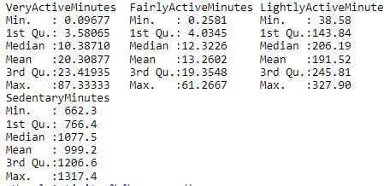
Customers Daily Activity
Insights related to customers activity and calories burnt
Customers workout for avg. of 20 min./day. to 30 min./day, which is pretty good (mayoclinic.com)
Customers wear device for avg. of 20 hrs./day.
Customers spend 16.5 hrs./day, sleeping or sitting.

Slide 12
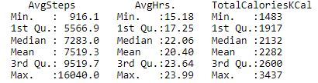
Customers Daily Activity
Insights related to customers activity and calories burnt
The avg. step count is close to 7,500 steps/day, which is less than 10,000 steps/day (ref. healthline.com).
Customers wear device for avg. of 20 hrs./day
The avg. calories of 2,282 KCal burnt per day, which is a good calorie burn count (ref. healthline.com)

Slide 13
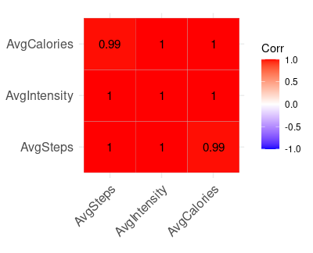
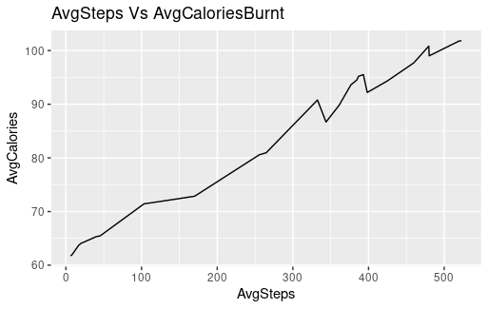
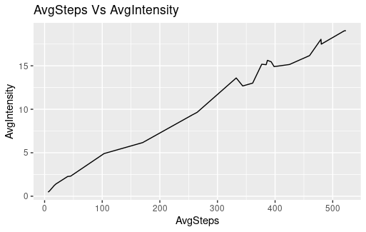
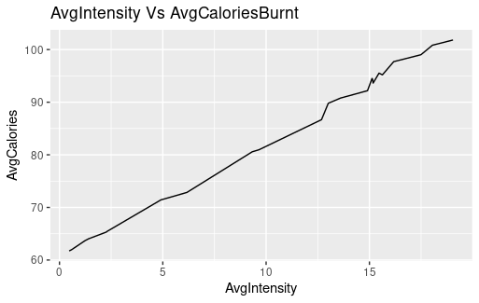
Customers Hourly Activity
Insights related to customers activity and calories burnt
There is high linear correlation between Calories burnt, Intensity of activity and steps taken.

Slide 14
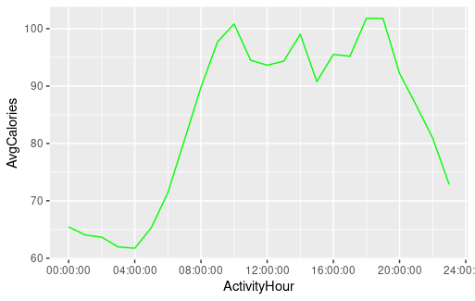
Customers Hourly Activity
Insights related to customers activity and calories burnt
Customers workout for avg. of 20 min./day. to 30 min./day, which is pretty good (mayoclinic.com)
Customers wear device for avg. of 20 hrs./day.
Customers spend 16.5 hrs./day, sleeping or sitting.
The active period seems to be 8AM to 8PM.
6PM to 7PM seems to be Gym/workout period.

Slide 15
Conclusion
The avg. recording of the device is 20 hrs. and the least recorded time period is 4 PM to 11 PM.
The daily workout time and calories count is close to ideal.
The step count and sedentary activity time count are far from ideal.

Slide 16
Suggestions
There should be fun notifications for reminding to wear the device while not being irritating.
Device should show ideal milestones for particular activities and cheer up messages for users.
There should be reminders/suggestions if specific values are far from ideal.
membership programs should be made encouraging to buy.

Slide 17
Thank You

